Slide 1
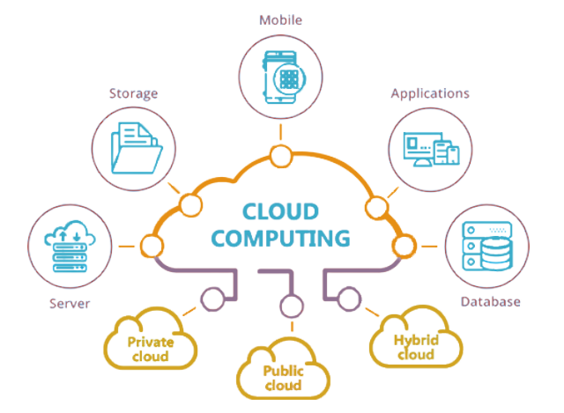
Introduction to Cloud Computing

Slide 2
Learning Objectives
Introduction to Cloud Computing
IaaS, PaaS, SaaS, On-Prem

Slide 3

Why Cloud Computing?

Slide 4
Scope of Cloud Computing
In demand high-end jobs like software architect and DevOps Engineer require cloud skills
https://www.bmc.com/blogs/cloud-growth-trends/
Indeed.com, identified the "booming" cloud skills as a major trend in the tech skills market.

Slide 5
Cloud Computing in Pakistan
booming industry in Pakistan
Government organizations' impressive results in cloud
HEC, PITB, and NTC
Private companies providing cloud services
RapidCompute, PTCL, Nayatel

Slide 6
What is Cloud Computing?
On-demand availability of computer system resources, especially computing power and storage
automation of virtualization
Storing and accessing data and programs over the internet
Notes:
Cloud computing transforms IT infrastructure into a utility:
It lets you ‘plug into' infrastructure via the internet,
and use computing resources without installing and maintaining them on-premises.

Slide 7
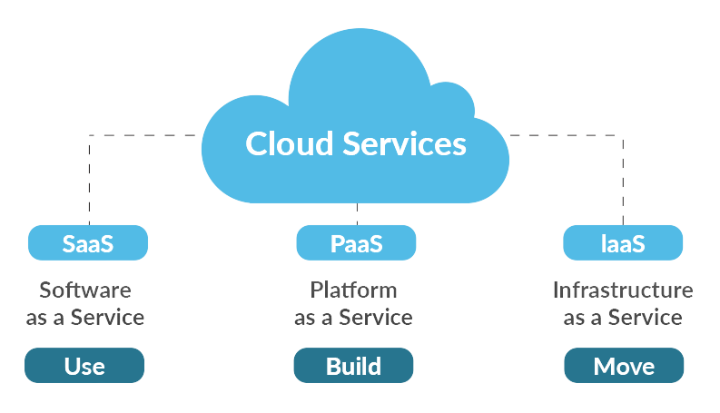
Service Models of Cloud Computing

Slide 8
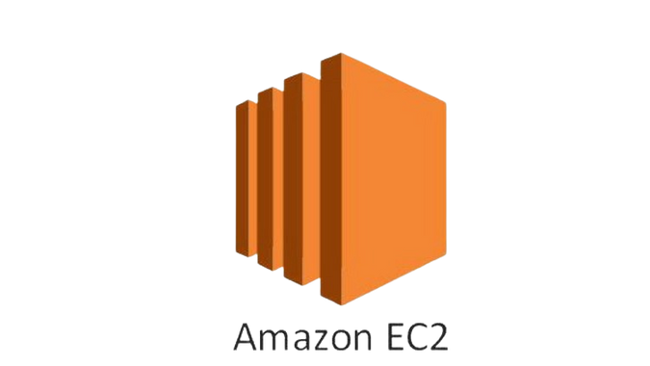
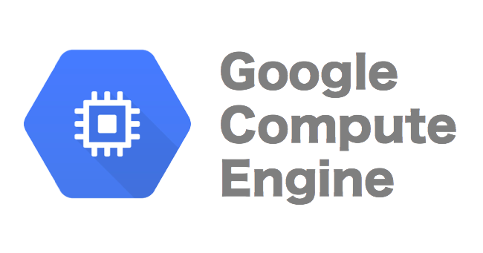
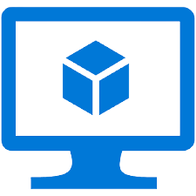
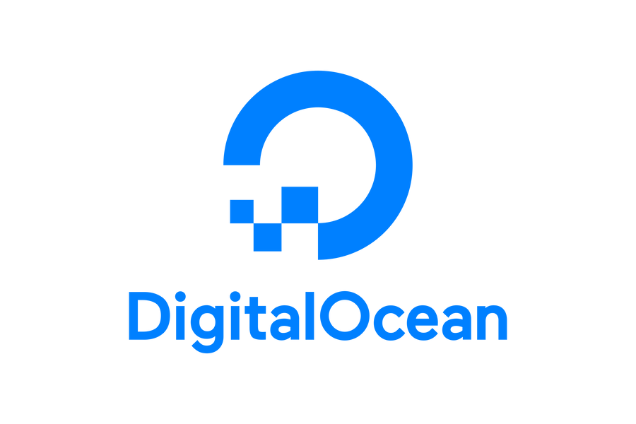

Infrastructure as a Service (IaaS)
Computing Resources over internet

Slide 9
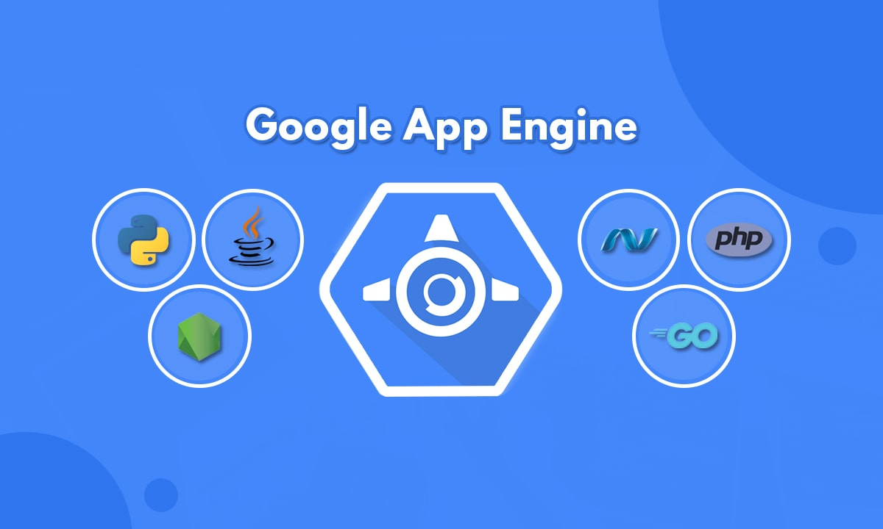

Platform as a Service (PaaS)
Tools over internet, usually for application development

Slide 10
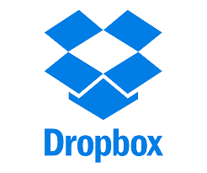
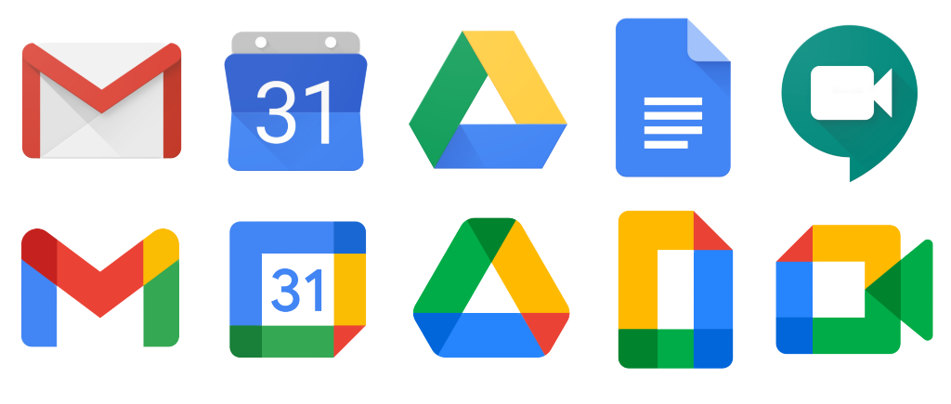

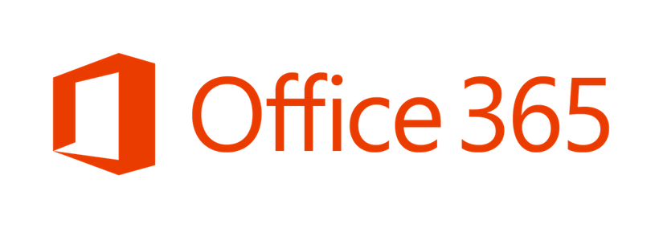
Software as a Service (SaaS)
Software Distribution Model

Slide 11
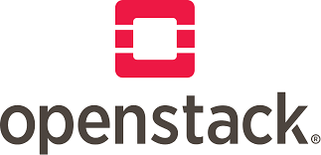

On-Prem Private Cloud
On-Site Cloud Infrastructure

Slide 12
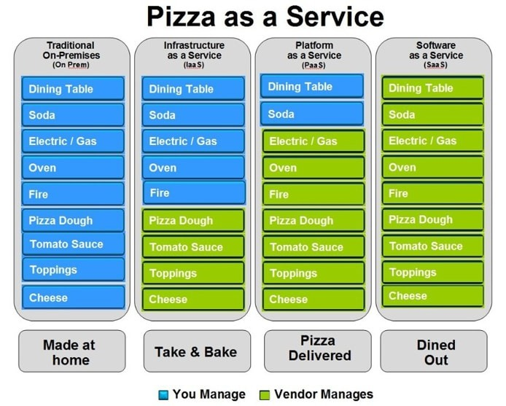

Slide 13
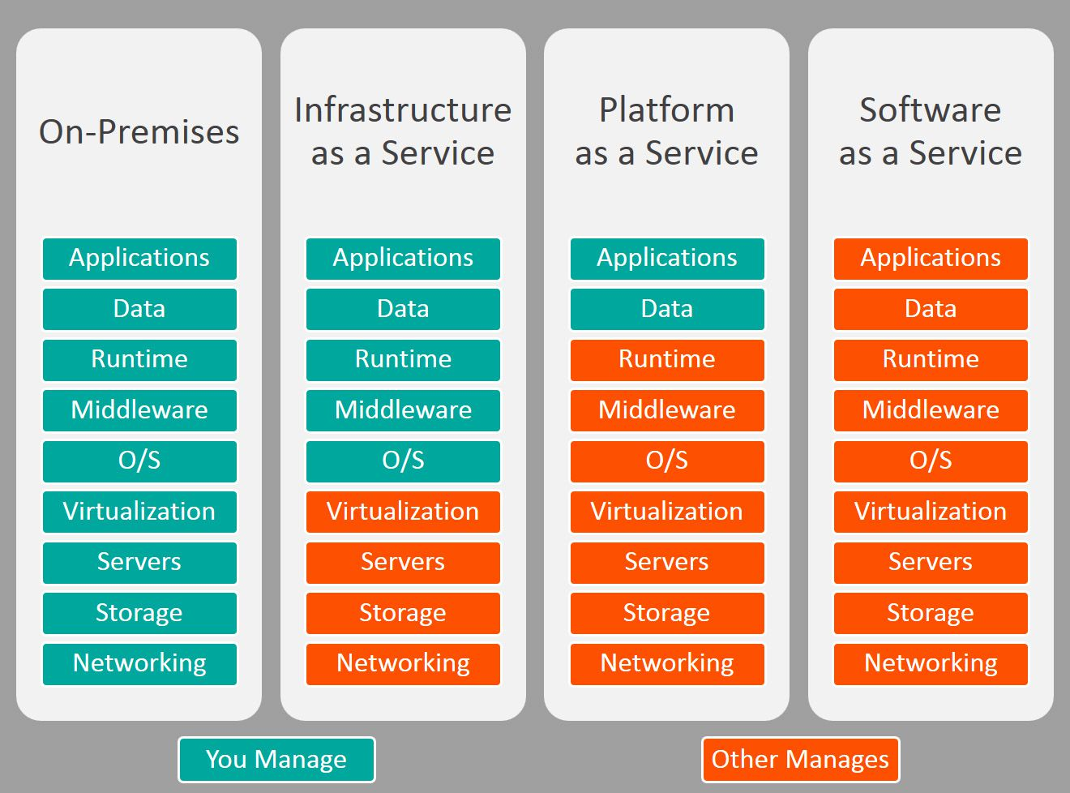

Slide 14
Cloud Deployment Models
Every organization has its own requirements as to what services it wants to access from a cloud.
To accommodate these varying requirements, a cloud environment can be implemented using different service models.
Public
Private
Hybrid

Slide 15
Public Cloud
In the public service model, all the systems and resources that provide the service are housed at an external service provider.
That service provider is responsible for the management and administration of the systems that are used to provide the service. The client is only responsible for any software or client application that is installed on the end-user system.
Connections to public cloud providers are usually made through the Internet.
Using the pay-per-usage method (API’s).

Slide 16
Advantages of Public Cloud
Low Cost
Location Independent
Save Time
Disadvantages of Public Cloud
Low Security
Public Cloud is less secure because resources are shared publicly.
Performance
In the public cloud, performance depends upon the speed of internet connectivity.
Less customizable

Slide 17
Private Cloud
In a private cloud, the systems and resources that provide the service are located internal to the company or organization that uses them. That organization is responsible for the management and administration of the systems that are used to provide the service.
In addition, the organization is also responsible for any software or client application that is installed on the end-user system.
Private clouds are usually accessed through the local LAN or wide area network (WAN).

Slide 18
Advantages of Private Cloud
More Control
Security & privacy
Improved performance
Disadvantages of Private Cloud
High cost
Restricted area of operations
Limited scalability
Skilled people

Slide 19
Hybrid Cloud
A hybrid cloud model is a combination of two or more other cloud models.
Hybrid cloud = public cloud + private cloud
The clouds themselves are not mixed together; rather, each cloud is separate, and they are all linked together.
A hybrid cloud may introduce more complexity to the environment, but it also allows more flexibility in fulfilling an organization’s objectives.

Slide 20
Advantages of Hybrid Cloud
Flexible and secure
Cost effective
Disadvantages of Hybrid Cloud
Due to private and public combination
Networking issues
Infrastructure Compatibility
Reliability

